Slide 1
Subject Code: HSS-01
Course Title: Economics
Subject Teacher: Falguni Pattanaik

Slide 2
Why to Study Economics…?
Why to learn economics?
  To learn how to avoid being deceived by economists
  Economics as a discipline exists because resources are limited
How can economics, being a science, be exciting for me to learn about?
  Economics studies the behavior of human beings within society- and that is what makes economics fascinating

Slide 3
Why to Study Economics…?
Don’t successful businesspeople operate on intuition? So is economics really useful for businesspeople?
  Economists just state the obvious
What can learning about economics do for me?
  “Economics may not keep you out of the unemployment line, but at least you will know why you are there”

Slide 4
Everyday Economics
Economics is approached as common sense
Economics is everywhere and for everyone.
  It is for people like you—educated, intelligent, and aware—who want to understand the world better and want to make the best decisions in their daily lives.
Economics is decision-making that not only involves allocating scarce resources to various use or uses but also is “rational.”

Slide 5
Economics and Choice
Economics is the study of how individuals and society manages its scarce resources.
“Economics is the study of how people and society choose to employ scarce resources that could have alternative uses in order to produce various commodities and to distribute them for consumption , now and/or in the future among various persons and groups in the society” by Samuelson and Nordhaous

Slide 6
How Economists Think
The first step in this process is to identify the fundamental economic problem: scarcity.
  What goods and services will be produced and in what quantities?
  How will they be produced?
  Who will consume them?

Slide 7
Decision Makers
Households are groups of people that live together.
Firms are organizations that use resources to produce goods and services.
Government is an organization that sets laws and rules, taxes, spends, and provides public services.

Slide 8
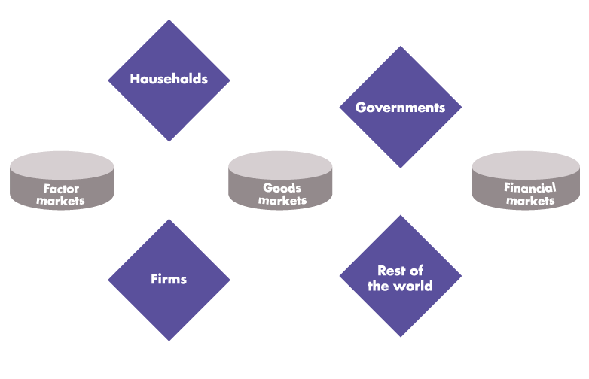
How Economy Works
  The circular flow diagram shows the transactions among households, firms, governments, and the rest of the world

Slide 9
How Economy Works
  These transactions take place in factor markets, goods markets, and financial markets.

Slide 10
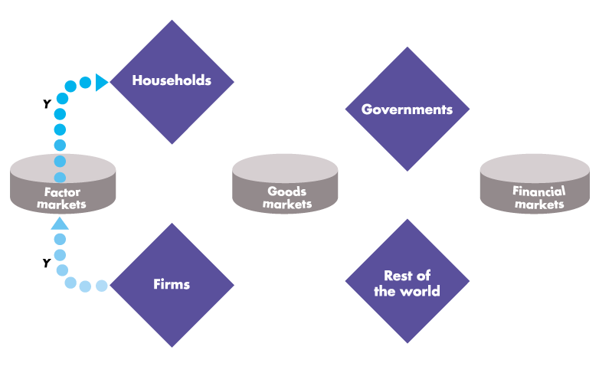
How Economy Works
  Firms hire factors of production from households. The blue flow, Y, shows total income paid by firms to households.

Slide 11
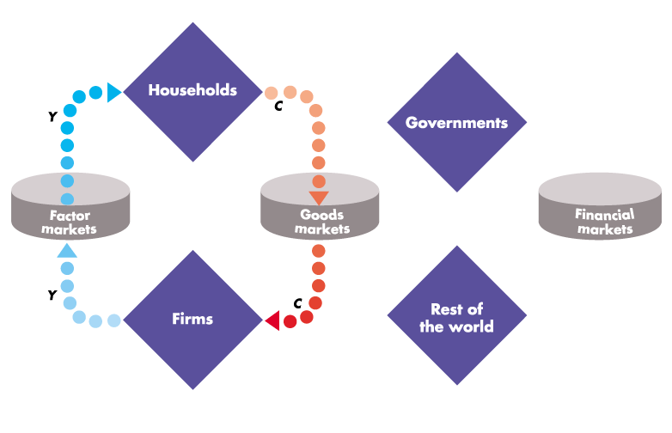
How Economy Works
  Households buy consumer goods and services. The red flow, C, shows consumption expenditures.

Slide 12
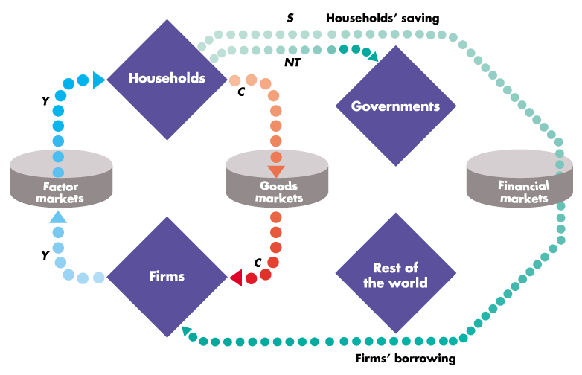
How Economy Works
  Households save, S, and pay net taxes, NT. Firms borrow some of what households save to finance their investment.

Slide 13
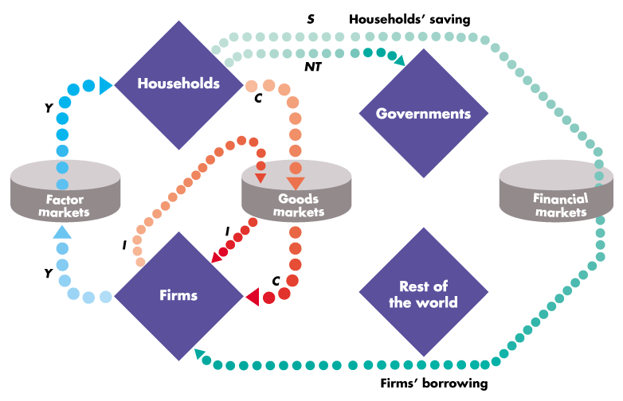
How Economy Works
  Firms buy capital goods from other firms. The red flow I represents this investment expenditure by firms.

Slide 14
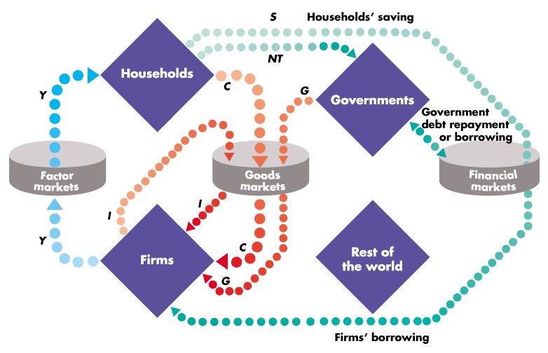
How Economy Works
  Governments buy goods and services, G, and borrow or repay debt if spending exceeds or is less than net taxes.

Slide 15
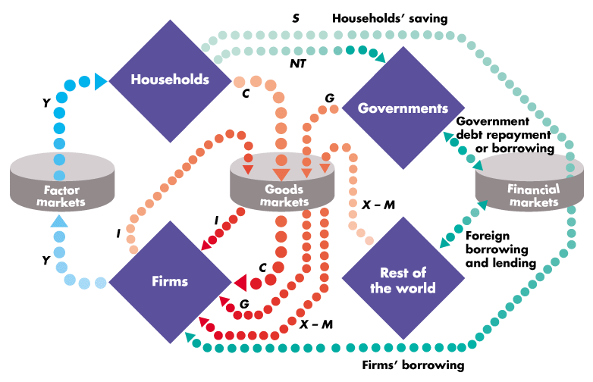
How Economy Works
  The rest of the world buys goods and services from us, X, and sells us goods and services, M. Net exports are X – M.

Slide 16
How Economy Works
  And the rest of the world borrows from us or lends to us depending on whether net exports are positive or negative.

Slide 17
What Economists Do
“economics is what economist do”
What are the “tools” of economics?
  Uses abstract models to help explain how a complex, real world operates.
  Develops theories, collects, and analyzes data to evaluate the theories.
What are the principal “schools of thought” in economics?

Slide 18
Economic Science and Economic Policy
Economic science is the attempt to understand the economic world.
  Science makes predictions.
Economic policy is the attempt to improve the economic world.
  Policy makes prescriptions.
Policies made without science usually will not be very good.

Slide 19
Economic Science is Young
Economics as a science is just over 200 years old.
Adam Smith’s The Wealth of Nations (1776) marks the beginning of our subject.
It began with Aristotle but got mixed up with ethics in the Middle Ages. Adam Smith separated it from ethics, and Walrus mathematized it. Alfred Marshall tried to narrow it, and Keynes made it fashionable. Robbins widened it, and Samuelson dynamized it, but modern science made it statistical and tried to confine it again.
Compared to physics and chemistry, however, we are newcomers.

Slide 20
Difference between Microeconomics and Macroeconomics
Economic questions can be divided into two big groups: microeconomics and macroeconomics.
Microeconomics focuses on the individual parts of the economy.
  How households and firms make decisions and how they interact in specific markets
Macroeconomics looks at the economy as a whole.
  Economy-wide phenomena, including inflation, unemployment, and economic growth

Slide 21
Suggested Books
Koutsoyiannis, A., “Modern Microeconomics”, Second Edition, Macmillon
Salvatore, D., “Principles of Microeconomics”, Fifth Edition, Oxford University Press
Mankiw, N.G., “Principles Of Microeconomics”, Sixth Edition, Cengage Learning India

